Slide 1

Red Hat JBoss Data Grid
November 15, 2013

Slide 2
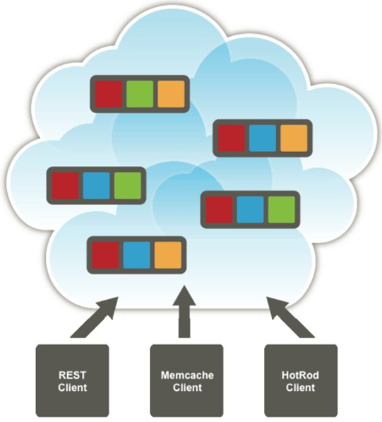
Introduction To Red Hat JBoss Data Grid
What is Red Hat JBoss Data Grid :
Based on Infinispan, the popular JBoss Community project, Red Hat JBoss Data Grid is the appropriate solution for any type of application that has heavy compute needs
JBoss Data Grid is a manageable, scalable, highly available, distributed, in-memory data store that lets you scale based on memory and distribution rather than relational database management system (RDBMS) licenses or database expertise
Data stored in the grid is usually synchronized, to balance load across all servers in the cluster as evenly as possible
Distributed data storage ENGINE composed over set of processes tat communicate with each other over a network where in each process is called a node

Slide 3

Overview Of Red Hat JBoss Data Grid
Why Red Hat JBoss Data Grid :
Tough requirements of high performance, availability, reliability, and elastic scale are met through JBoss Data Grid.
Handle unprecedented transaction volumes.
Meet high uptime requirements and deploy into hybrid cloud environments.
Provide access to accurate, real-time information
Streamline interaction with complex and rigid data tiers
Multiple access protocols – It is easy to access the data grid using REST, Memcached, Hot Rod, or simple map-like API.

Slide 4





Overview Of Red Hat JBoss Data Grid
Where to use Red Hat JBoss Data Grid :
It can be any type of application that requires heavy interaction with a data tier. Typical use cases include:
Retail and e-commerce: B2B partner-procurement data and consumer catalogs
Financial services: Options and stock-trading performance optimization
Media and entertainment: On-demand video and data management
Telecommunications
Transportation and logistics
Travel

Slide 5
Features Of Red Hat JBoss Data Grid
Features :
Schema-less key value store: Red Hat JBoss Data Grid is an in memory NoSQL database that provides a simple and flexible means to storing different objects without a fixed data model
Grid-based data storage and distributed processing: Red Hat JBoss Data Grid is a federated cluster of services to distribute, replicate, and store data, designed to seamlessly implemented , with no additional development work. Processes can be pushed to these data services to distribute workload and provide high-performance due to affinity and efficient use of compute power
Elastic scaling: Adding and removing storage nodes is achieved simply, is non-disruptive, and scale is linear. Scaling a data grid is as simple as configuring and launching a new process. All the work is completed in the background to ensure data remains distributed and replicated.
Multiple access protocols: It is easy to access the data grid using REST, memcached, Hot Rod, or through a simple java map API. The variety of access models means any sort of application – legacy or new, java or native, in-memory or remote can easily access data in the grid.
Management Tooling: JBoss Data Grid is available as a subscription from Red Hat and also includes a subscription to the JBoss Operations Network. JBoss Operations Network is a middleware and application management solution tat provides a single point of control to deploy, manage, and monitor JBoss Enterprise Middleware, applications and services

Slide 6
Advantages and Disadvantages of
Red Hat JBoss Data Grid
Advantages :
It is the best way to build high performing, resilient, and scalable web applications
Enhanced performance because data can be written to, and read from, memory much faster than is possible with a hard disk.
The data grid can be easily scaled, and upgrades can be easily implemented.
A key/value data structure, rather than a relational structure, provides flexibility for application developers
The technical advantages provide business benefits in the form of faster decision making, greater productivity, and improved customer service.
Easily handle huge transaction volumes
Meet high uptime expectations
Deploy in open hybrid cloud environments
Meet demands for accurate, real-time information Streamline interactions with the complex, rigid data tiers

Slide 7
Advantages and Disadvantages of
Red Hat JBoss Data Grid
Benefits :
Performance : Accessing objects from local memory is faster than accessing objects from remote data stores (such as a database). JBoss Data Grid provides an efficient way to store in-memory objects coming from a slower data source, resulting in faster performance than a remote data store. JBoss Data Grid also offers optimization for both clustered and non clustered caches to further improve performance.
Consistency : Storing data in a cache carried the inherent risk: at the time it is accessed, the data may be outdated (stale). To address this risk, JBoss Data Grid uses mechanisms such as cache invalidation and expiration to remove stale data entries from the cache. Additionally, JBoss Data Grid supports JTA, distributed (XA) and two-phase commit transactions along with transaction recovery and a version API to remove or replace data according to saved versions.
Massive Heap and High Availability : In JBoss Data Grid, applications no longer need to delegate the majority of their data lookup processes to a large single server database for performance benefits. JBoss Data Grid employs techniques such as replication and distribution to completely remove the bottleneck that exists in the majority of current enterprise applications.

Slide 8


Three main features which makes JDG impressive
Scalability :
Consistent-hash based data distribution
Based on the proven Amazon Dynamo paper and design
Linear in nature
Throughput (Transaction per second)
Capacity
Consistency :
Strongly Consistent - Congruent with most databases
JTA Transactions
Fully XA Complaint - with XA Recovery Support

Slide 9
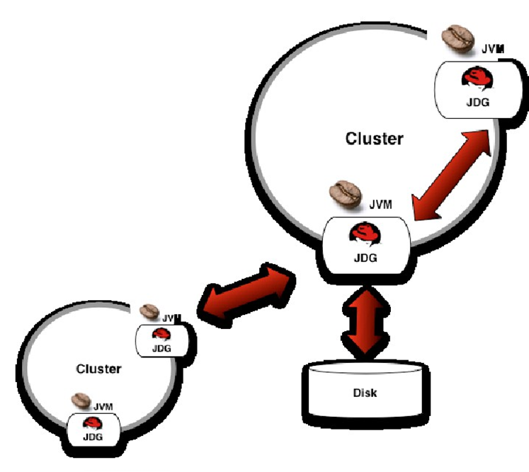
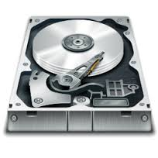
Three main features which makes JDG impressive
Durability :
Persistence to disk or database
Replication to secondary cluster
Writing to disc
Supported Storage engines:
File system
JDBC Database
custom [write your own pluggable implementations]

Slide 10
Thank you
Visit us at www.techmahindra.com

